Slide 1
The Practice of Citing Scientific Sources in the Chicago Style Part 2 - Electronic sources -

Slide 2
Quotation machine/generator

Slide 3
Quotation machine/generator
create bibliography entry
http://www.citationmachine.net/
titles and subtitles are capitalized headline-style (English).
http://www.eturabian.com (free account)
http://www.gobiblio.com/
http://www.easybib.com/

Slide 4
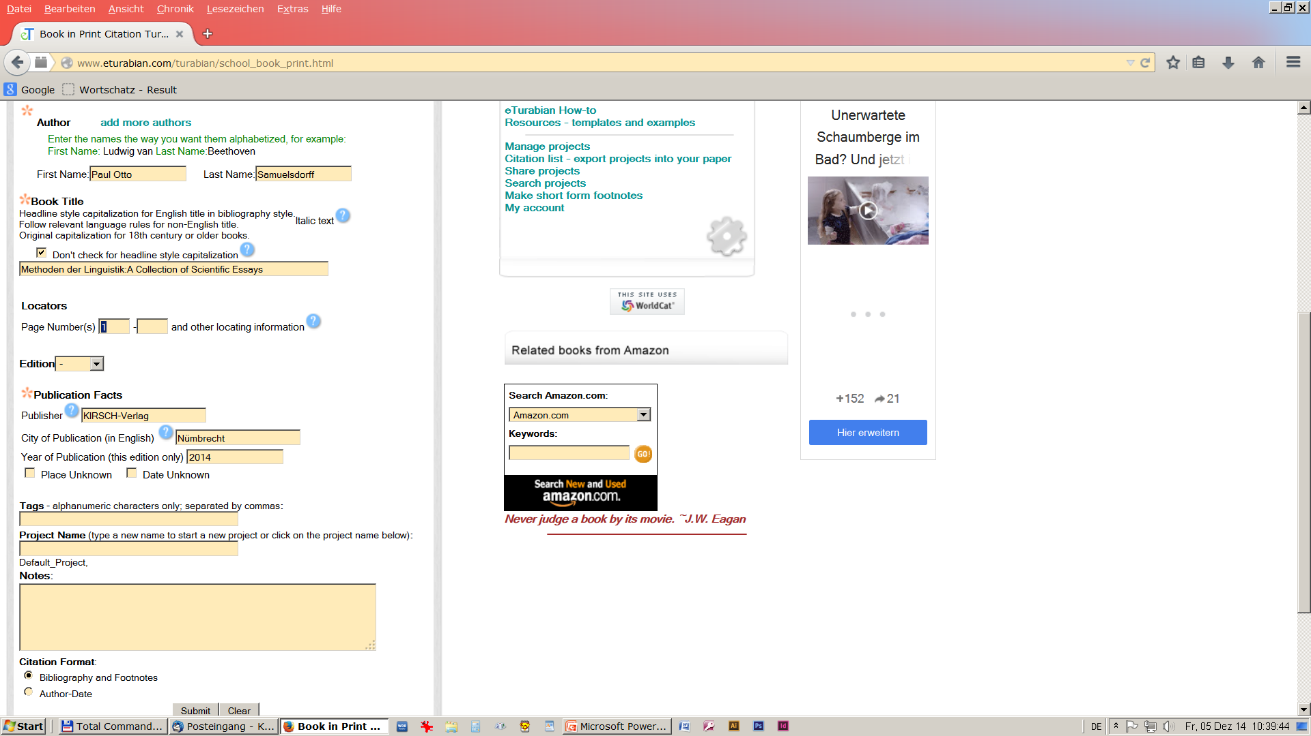
www.eturabian.com

Slide 5
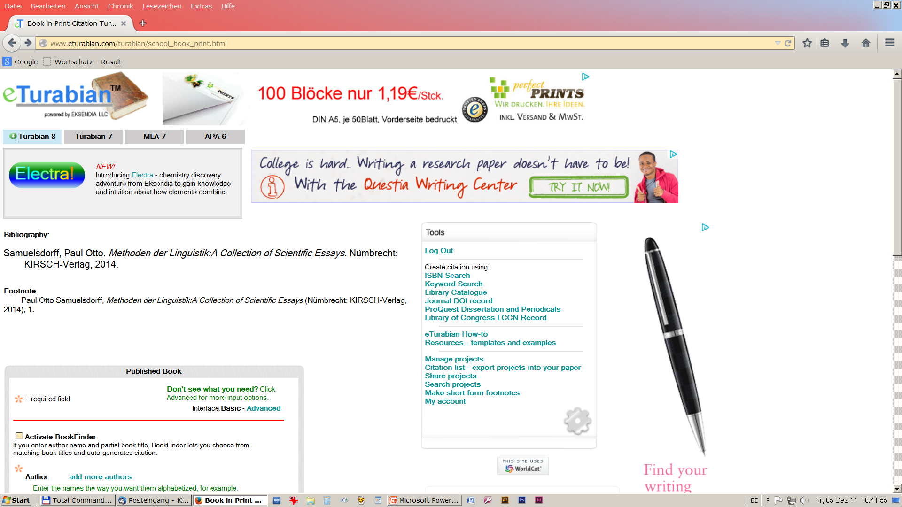
created bibliography entry/footnote

Slide 6
electronic publications

Slide 7
electronic publication (›15.4, »14.4, »8.186)
permanence [Dauerhaftigkeit, Beständigkeit]
with permanence:
CD-ROM/DVD (›17.5.8, »14.166)
DOI - digital object identifier (›15.4.1.3, »14.6)
= URN
e-books (›17.1.10)
stable page numbers
page numbers vary
without permanence:
Websites, URL (»14.18)
web-based publication (»1.111)
Journals (»1.72)
access date (»14.7)

Slide 8
Internet (URL) (›15.4.1.3, »14.9)
websites are located by a URL
uniform resource locator
http://kups.ub.uni-koeln.de
anything posted on the Internet is ‘published’ in the sense of copyright
last modified-date (»14.248, »14.248)
access(ed) date
[abgerufen am ...]

Slide 9
structure of a URL
http://www.press.uchicago.edu/books/turabian/
http:// Protocol
www.press.uchicago.edu hostname
books/turabian path
turabian_citationguide.html specific document
How to break a URL? (›20.4.2)
http://
www.press.uchicago.edu
http://www.press.uchicago.edu/books/turabian
/turabian_citationguide.html

Slide 10
URL-quotation (›15.4.1.3, »14.11)
Gierse, Niels. Assessment of Laser Induced Ablation Spectroscopy (LIAS) as a method for quantitative in situ surface diagnostic in plasma environments. Dissertation, Universität zu Köln. http://kups.ub.uni-koeln.de/5771/.

Slide 11
access date (»14.185)
Bibliography:
Bunčić, Daniel. „Die (Re-)Nationalisierung der serbokroatischen Standards.“ Dissertation, Universität zu Köln, 2008. Abgerufen 07. November 2014. http://kups.ub.uni-koeln.de/ id/eprint/5152.
Note:
... . Accessed november 07, 2014. http://kups.ub.uni-koeln.de/ id/eprint/5152.

Slide 12
Publications server
URN uniform resource name
Bibliography with URN
Bunčić, Daniel. „Die (Re-)Nationalisierung der serbokroatischen Standards.“ Dissertation, Universität zu Köln, 2008. http://nbn-resolving.de/urn:nbn:de:hbz:38-51529.
footnote:
______________________
¹ Bunčić, „Die (Re-)Nationalisierung der serbokroatischen Standards.“
https://nbn-resolving.org/

Slide 13
e-Journals
bibliography
Dorgerloh, Hartmut und Jürgen Luh (Hrsgg.). zeitenblicke 7, Nr. 1. 2008. Abgerufen am 07. November 2014, http://www.zeitenblicke.de/2008/1/ .
Hagemann, Alfred P. „Ein Preußenschloss für den Arbeiter- und Bauernstaat – Schloss Schönhausen 1945-1990“, 2008. In zeitenblicke 7 Nr. 1. urn:nbn:de:0009-9-13178.
https://nbn-resolving.org/urn:nbn:de:0009-9-13178

Slide 14
e-books
Books downloaded from a library or bookseller
as printed counterpart.
The citing author must indicate
that he has consulted a format other than print.
Austen, Jane. Pride and Prejudice. New York: Penguin Classics, 2007. Kindle edition.

Slide 15
e-books
e-books (›17.1.10)
stable page numbers (PDF)
page numbers vary (»14.17)
‘locator ’ (›17.1.7, »14.17)

Slide 16
periodicals (»14.173)
Hope A. Olson, “Codes, Costs, and Critiques: The Organization of Information in Library Quarterly, 1931–2004,” Library Quarterly 76, no. 1 (2006): 20, doi:10.1086/504343.
citation/footnote: ________________________
³⁴ Olson, “Codes, Costs, and Critiques,” 22–23.

Slide 17
websites (»14.245)
Citations of website content:
“Google Privacy Policy,” last modified October 14, 2005, accessed July 19, 2008, http://www.google.com/intl/en/privacypolicy.html.
“McDonald’s Happy Meal Toy Safety Facts,” McDonald’s Corporation, accessed July 19, 2008, http://www.mcdonalds.com/corp/about/factsheets.html.
Barack Obama’s Facebook page, accessed July 19, 2008, http://www.facebook.com/barackobama.

Slide 18
End Part II

